Slide 1

Graph ML For Anti-Fraud
Nelson LIN
Fraud Operations Analyst

Slide 2
Graph ML For Anti-Fraud
NLP Overview
Graph Definition
What is Graph ML, vs traditional ML:
What can Graph ML used for ?
  Node Classification
  Link Prediction
  Community Detection
  Network Similarity
Why is it widely adopted in anti-fraud ?
Technical Demonstration
  Graph Representation
  Node Classification
  Industrial Example
Challenges

Slide 3
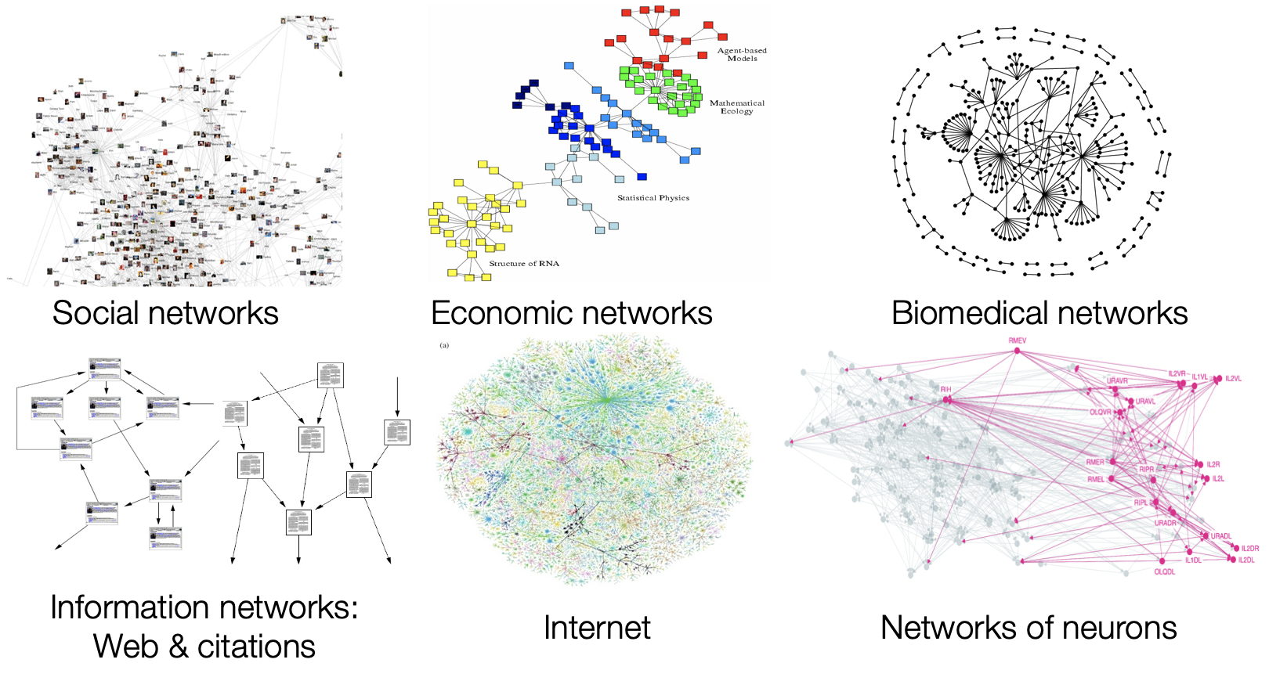
Graph ML For Anti-Fraud
NLP Overview
Graph Definition:
Graph is a structure composed of nodes and edges.
1) Nodes are usually entities. For example, people, institutions, cells, and commodities can all be used as a node.
2) An edge represents the connection relationship between nodes. For example, in a social network, a person is one of the nodes, and an edge between two nodes indicates that the two people may be friends or share the same article.
3) The nodes in the graph can also have characteristics or attributes, such as nodes representing customers, whose attributes are usually age, gender, monthly consumption, etc., and nodes representing commodities, and their attributes are usually commodity types, brands, and prices.
Notes:
Graph is a structure composed of nodes and edges.
Nodes are usually entities. For example, people, institutions, cells, and commodities can all be used as a node.
An edge represents the connection relationship between nodes. For example, in a social network, a person is one of the nodes, and an edge between two nodes indicates that the two people may be friends or share the same article.
In the e-commerce system, customers and commodities can be regarded as nodes, and the edges in them usually indicate that a certain customer has purchased a certain commodity.
The nodes in the graph can also have characteristics or attributes, such as nodes representing customers, whose attributes are usually age, gender, monthly consumption, etc., and nodes representing commodities, and their attributes are usually commodity types, brands, and prices.
From this graph composed of customers and products, we can learn the consumption habits of customers, thereby enhancing the effect of the product recommendation system.

Slide 4
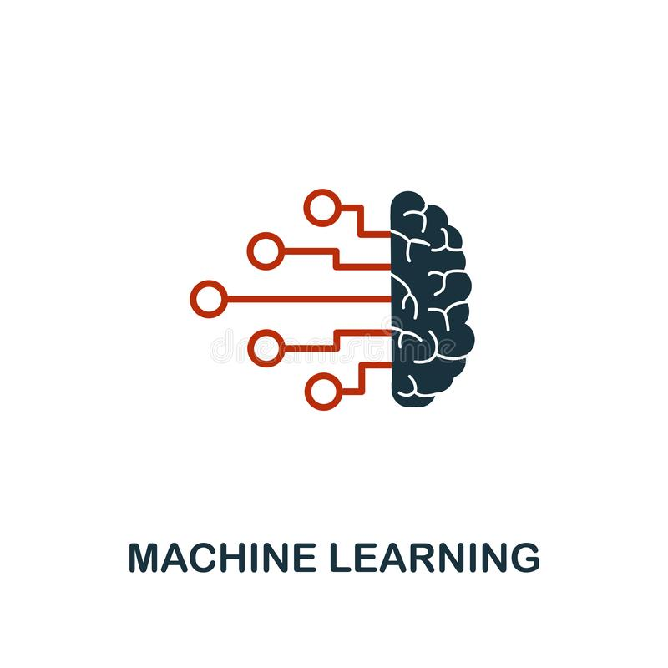
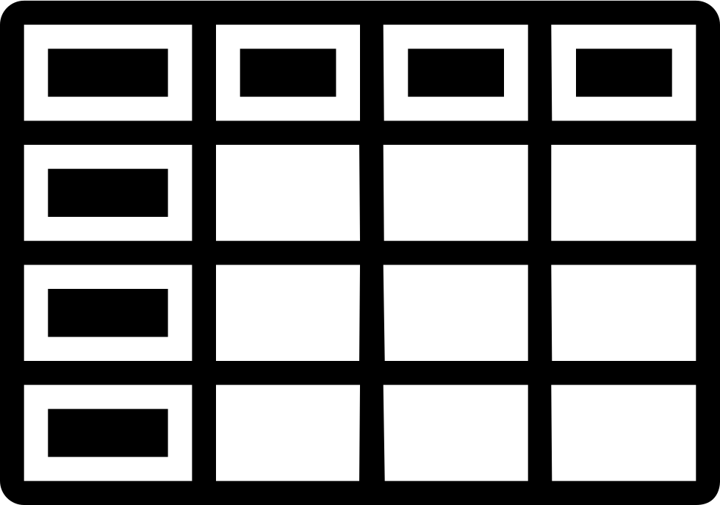
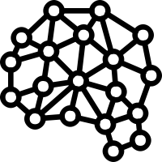
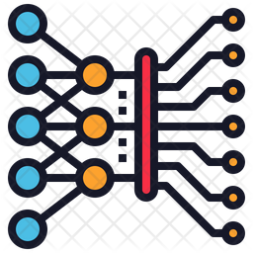
What is Graph ML, vs traditional ML
NLP Overview
Graph ML and its specialties:
Network Structure transformation
Customized Structure to capture the topology
Notes:
Graph is a structure composed of nodes and edges.
Nodes are usually entities. For example, people, institutions, cells, and commodities can all be used as a node.
An edge represents the connection relationship between nodes. For example, in a social network, a person is one of the nodes, and an edge between two nodes indicates that the two people may be friends or share the same article.
In the e-commerce system, customers and commodities can be regarded as nodes, and the edges in them usually indicate that a certain customer has purchased a certain commodity.
The nodes in the graph can also have characteristics or attributes, such as nodes representing customers, whose attributes are usually age, gender, monthly consumption, etc., and nodes representing commodities, and their attributes are usually commodity types, brands, and prices.
From this graph composed of customers and products, we can learn the consumption habits of customers, thereby enhancing the effect of the product recommendation system.

Slide 5
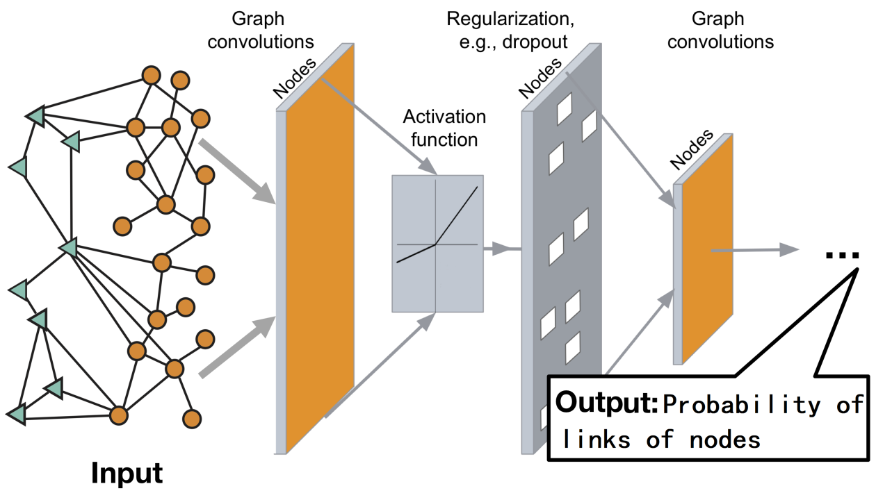
What can Graph ML be used for ?
NLP Overview
Graph ML Four Major Tasks:
Academia has been studying graph networks for more than ten years. Graph ML mainly focuses on four types of graph network tasks:
Graph node classification:
  Elements preference prediction on social media
  Fraudster Identification among transaction.
Graph Linkage prediction:
  Friend recommendation on social media
  Product Recommendation on e-commerce
Community discovery:
  Fraudulent Community detection
Network similarity:
  Compare two complex protein structures
  Same Interested Group Identification
Notes:
Graph is a structure composed of nodes and edges.
Nodes are usually entities. For example, people, institutions, cells, and commodities can all be used as a node.
An edge represents the connection relationship between nodes. For example, in a social network, a person is one of the nodes, and an edge between two nodes indicates that the two people may be friends or share the same article.
In the e-commerce system, customers and commodities can be regarded as nodes, and the edges in them usually indicate that a certain customer has purchased a certain commodity.
The nodes in the graph can also have characteristics or attributes, such as nodes representing customers, whose attributes are usually age, gender, monthly consumption, etc., and nodes representing commodities, and their attributes are usually commodity types, brands, and prices.
From this graph composed of customers and products, we can learn the consumption habits of customers, thereby enhancing the effect of the product recommendation system.

Slide 6
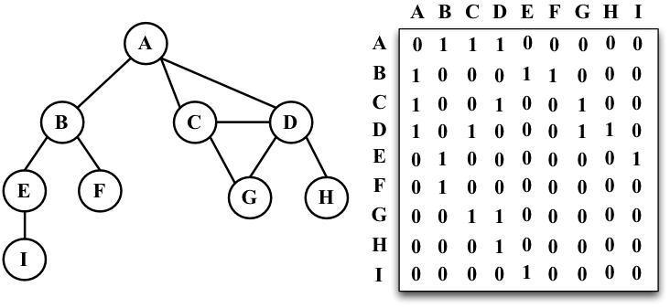
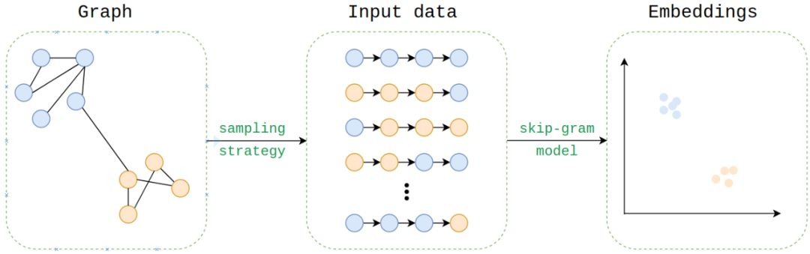
Technical Demonstrations
NLP Overview
Graph Representation:
Graph is an unstructured data. Usually, when we leverage unstructured data, we have to transformed it to be structured data.
Adjacency Matrix
Node2Vec
Adjacency Matrix
Node2Vec

Slide 7
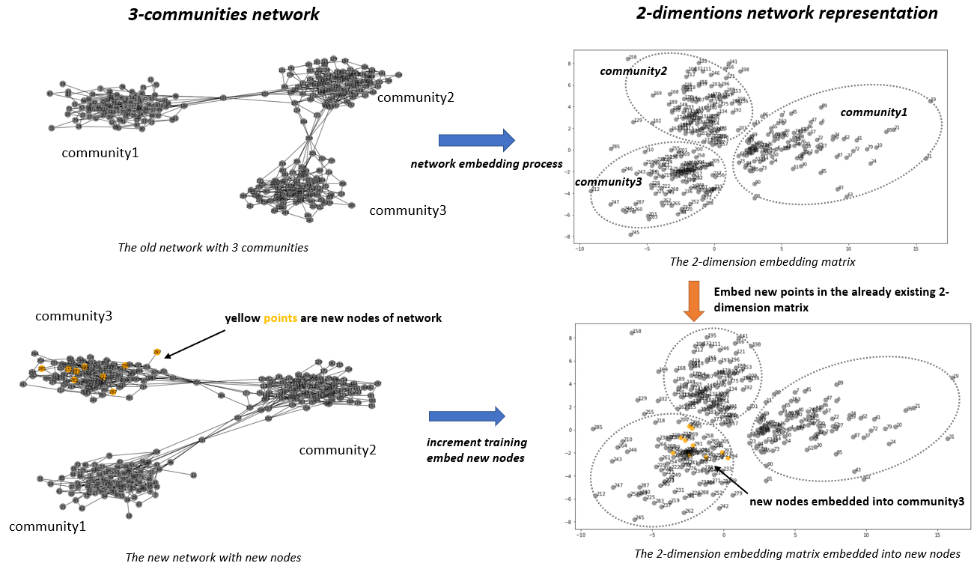
Technical Demonstrations
NLP Overview
Graph Representation: Node2Vec
Graph is an unstructured data. Usually, when we leverage unstructured data, we have to transformed it to be structured data.
Demonstration: DeepWalk to convert a graph network to be a dense matrices using Skim-Gram

Slide 8
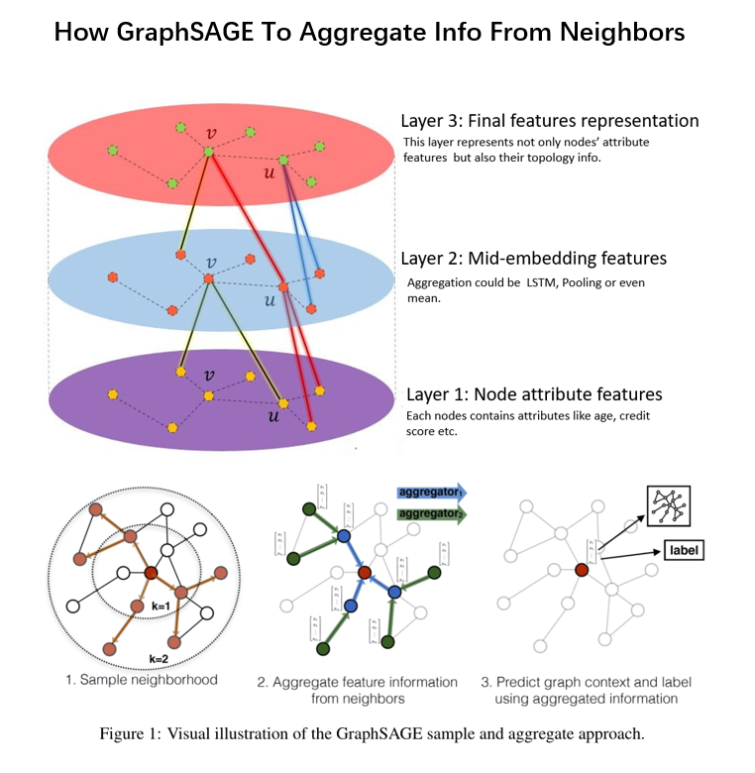
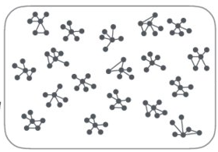
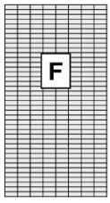
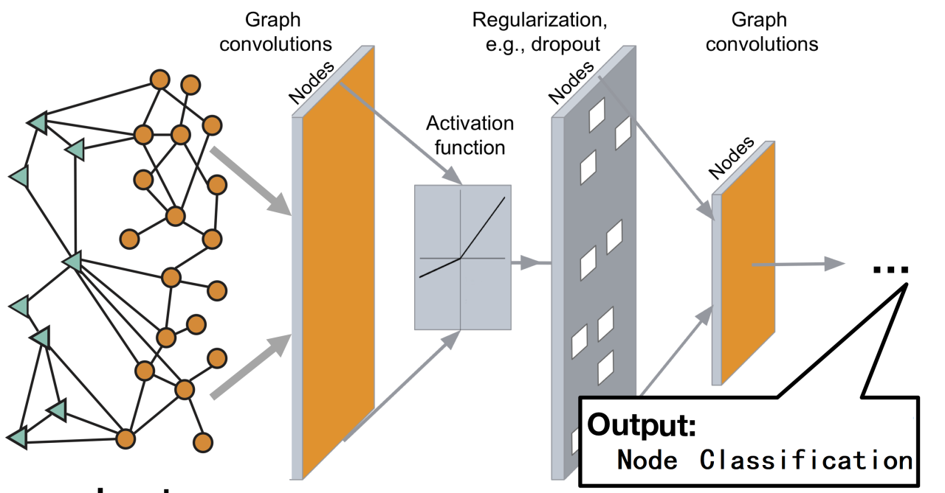

Technical Demonstrations
NLP Overview
Node Classification:
Capturing network information to classify which category the node belong to.
Two Technical Implementations:
node2vec: Feature Provision for downstream ML
neighborhood aggregation: End-to-End ML such GNN, GraphSage etc.
Node2vec Features
Static Features: Age, gender etc.

Slide 9
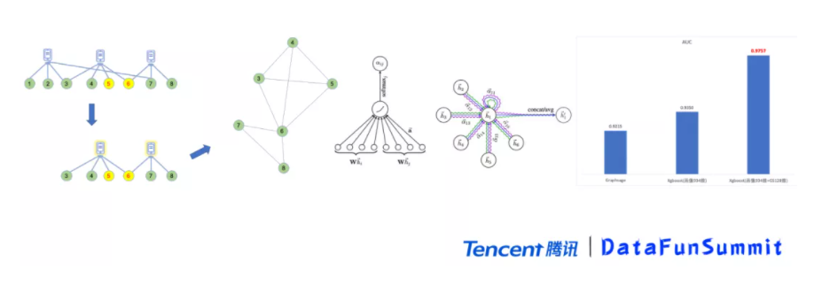
Technical Demonstrations
NLP Overview
Industrial Example: WeChat Fraudulent Detection
Usually, a fraudulent community does have only on device and each device login several accounts.
This is example of how to transform a devices-and-accounts (heterogeneous) graph to be to construct an isomorphic graph, to detect fraud by using GraphSage:
heterogeneous graph – different entities
isomorphic – same entities
If only GNN is used to run supervised learning, the AUC is 0.92, which is slightly worse than 0.93 obtained by XGBoost running portrait features, but if the individual Embedding learned by GNN is spliced to the original portrait features, then run XGBoost , AUC will be greatly increased to 0.97, which also shows that network structure features can bring significant gains to the original individual portrait features.
Notes:
We prefer to use the neighbor aggregation algorithm, because supervised learning is better for us to grasp the direction of optimization. For example, the following picture has 1 to 8 points, 5 and 6 are marked abnormal points (because graph calculations are all semi-supervised learning, so we also need to make certain markings), and then 1, 2 The point has a multi-hop relationship with them and can be removed. This is a one-step noise reduction. Our running graph algorithm will eventually turn a heterogeneous graph into an isomorphic graph. As shown in the figure above, although this example only reduces 2 nodes, the edges that generate the isomorphic graph may be reduced by half. Through experimental comparison, if only GNN is used to run supervised learning, the AUC is 0.92, which is slightly worse than 0.93 obtained by XGBoost running portrait features, but if the individual Embedding learned by GNN is spliced to the original portrait features, then run XGBoost , AUC will be greatly increased to 0.97, which also shows that network structure features can bring significant gains to the original individual portrait features.

Slide 10
Challenges
NLP Overview
Positive labels are almost rare:
  The number of historical fraudsters usually is not sufficient for ML to recognize the pattern but data augment may help.
Demanding for historical data storage
  It’s demanding to capture the historical data, such as fraudster social network images.
Intensive and complex computation to transforms graph data to structure data
  Origin data could be very huge with a long-time span.

